Slide 1
Searching Algorithms

Slide 2
A simple example: traveling on a graph
Basic Terms:
Cost function that determines the cost of each action or a sequence of actions.
Solution: path from initial state to a goal state.
Optimal solution: solution with minimal cost.
2
C
B
9
2
3
goal state
F
start state
A
E
D
4
3
4

Slide 3
Generic search algorithm
Fringe = set of nodes generated but not expanded
= nodes we know we still have to explore
fringe := {node corresponding to initial state}
loop:
if fringe empty, declare failure
choose and remove a node v from fringe
check if v’s state s is a goal state; if so, declare success
if not, expand v, insert resulting nodes into fringe
Key question in search: Which of the generated nodes do we expand next?

Slide 4
Uninformed Search

Slide 5
Uninformed search
Uninformed search: given a state, we only know whether it is a goal state or not.
Cannot say one non-goal state looks better than another non-goal state.
Can only traverse state space blindly in hope of somehow hitting a goal state at some point.
Also called blind search
Examples are:
Breath-first search (BFS)
Depth-first search (DFS)
Uniform cost search (UCS)

Slide 6
Breadth-first search
Breadth first search (BFS) is a graph search algorithm that begins at the root node and expands all the neighboring nodes. Then for each of those nearest nodes, it expands their unexplored neighbor nodes, and so on, until it finds the goal. The algorithm uses a queue data structure to store intermediate results as it traverses the graph.
Algorithm:
1. Enqueue the root node
2. Dequeue a node and examine it
i) If the element sought is found in this node , quit the search and return a result.
ii) Otherwise enqueue any successor(the direct child nodes) that have not yet been discovered.
3. If the queue is empty, every node on the graph has been examined- quite the search and return “not found”.
4. If the queue is not empty, repeat from step 2

Slide 7
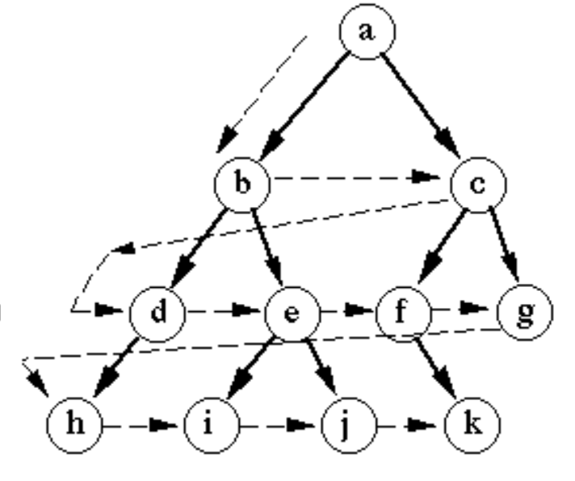
Breadth-first search
Example:

Slide 8
Properties of breadth-first search
Nodes are expanded in the same order in which they are generated
Fringe can be maintained as a First-In-First-Out (FIFO) queue
BFS is complete: if a solution exists, one will be found
BFS finds a shallowest solution
Not necessarily an optimal solution
If every node has b successors (the branching factor), first solution is at depth d, then fringe size will be at least b^{d} at some point. So, space complexity of BFS is O(b^{d})
At depth 0 (root) ->1 node; depth 1-> up to b nodes; depth 2 -> up to b^2 nodes;... depth d -> up to b^{d} nodes. Total number of nodes generated is: 1+b+b²+⋯+b^{d}. So, time complexity of BFS is O(b^{d})

Slide 9
Depth-first search
Depth-First Search (DFS) is a graph search algorithm that starts at the root node and explores as far as possible along each branch before backtracking. The algorithm uses a stack (either explicitly or via recursion) to keep track of nodes to visit next.
Algorithm:
1. Push the root node onto the stack.
2. Pop a node and examine it:
i) If the target is found, return the result.
ii) Else, push any unvisited neighboring nodes onto the stack.
3. If the stack is empty, every node has been examined—return "not found.“
4. If the stack is not empty, repeat from Step 2.

Slide 10
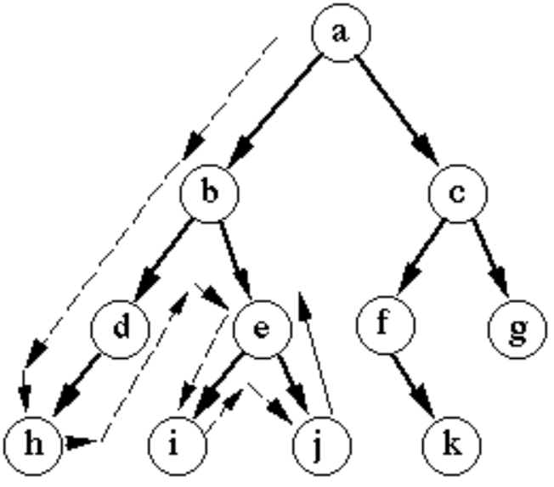
Depth-first search
Example:

Slide 11
Properties of depth-first search
For depth m, the worst case is storing b nodes for each of the m levels
Not complete (might cycle through non-goal states)
Fringe can be maintained as a Last-In-First-Out (LIFO) queue (aka. a stack)
If solution found, generally not optimal/shallowest
DFS returns the first solution it encounters, which may be deep in the tree.
If every node has b successors (the branching factor), and we search to at most depth m, fringe is at most bm (For depth m, the worst case is storing b nodes for each of the m levels ). So, Space complexity of DFS is O(b.m)
Much better space requirement ☺
Actually, generally don’t even need to store all of fringe
Time: DFS explores all possible paths, leading to O(b^{m}) time
b^{m} + b^{m-1} + … + 1 (for b>1, O(b^{m}))
a b d
Goal = d

Slide 12
Combining good properties of BFS and DFS
Limited depth DFS: just like DFS, except never go deeper than some depth d
Iterative deepening DFS:
Call limited depth DFS with depth 0;
If unsuccessful, call with depth 1;
If unsuccessful, call with depth 2;
Etc.
Complete, finds shallowest solution
Space requirements of DFS
May seem wasteful timewise because replicating effort
Really not that wasteful because almost all effort at deepest level
db + (d-1)b² + (d-2)b³ + ... + 1b^{d} is O(b^{d}) for b > 1

Slide 13
Time complexity of DLS and IDS for b=10 and d=5
For Depth Limited Search:
The number of expansions to a depth of d with branching factor b is: 1 + b + b² + . . . + b^{d -2} + b^{d -1} + b^{d} For b =10 and d =5
1 + 10 +100+1000+10000+100000 = 111,111
For Iterative Deeping Search:
For each expansion to depth k, the root has been expanded k + 1 times, the next level k times, etc., giving: (d +1)1 + (d)b + (d -1)b² + . . . + 3b^{d -2} + 2b^{d -1} + b^{d} For b =10 and d =5
6*1 + 5*10 + 4*100 + 3*1000 + 2*10000 + 1*100000 = 123,456

Slide 14
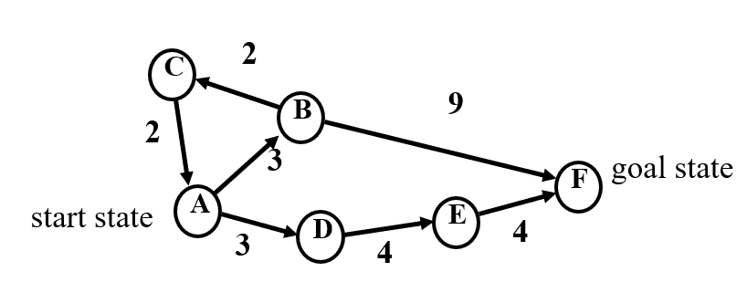
Uniform cost search Uniform-cost search is a blind search approach which is the extension of BFS. It is optimal because, at every step the path with the least cost is chosen
state = A,
cost = 0
state = B,
cost = 3
state = D,
cost = 3
state = C,
cost = 5
state = F,
cost = 12
state = E,
cost = 7
state = A,
cost = 7
state = F,
cost = 11
goal state!
state = B,
cost = 10
state = D,
cost = 10

Slide 15
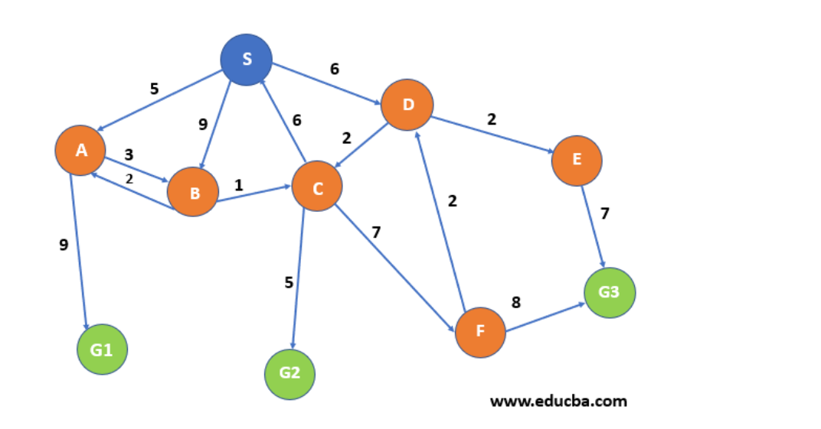
Uniform cost search Exercise:

Slide 16
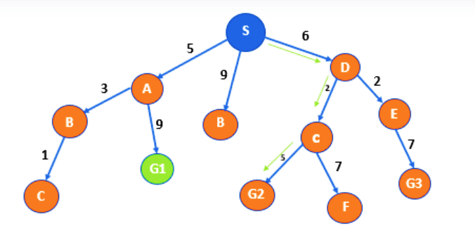
Uniform cost search Solution:

Slide 17
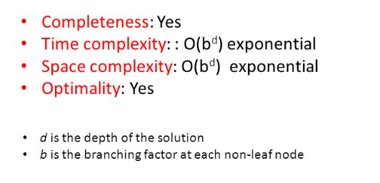
Properties of uniform cost search

Slide 18
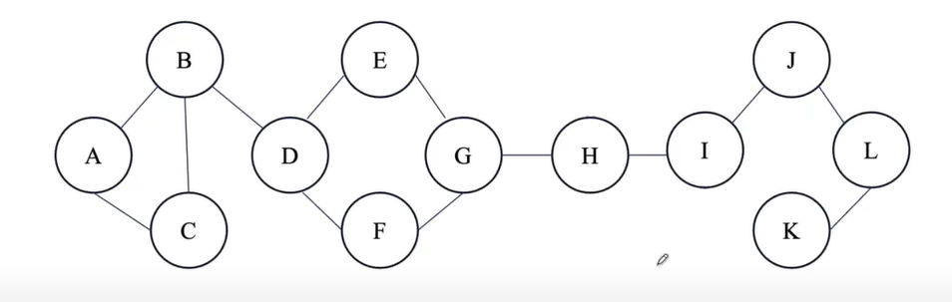
Searching backwards from the goal
Sometimes we can search backwards from the goal
Need to be able to compute predecessors instead of successors.
Bidirectional search
Even better: search from both the start and the goal, in parallel!
The bidirectional search is to reduce the search time by searching forward from the start and backward from the goal simultaneously. When the two search frontiers intersect, the algorithm can reconstruct a single path that extends from the start state through the frontier intersection to the goal.
This is speedy because of its two way search. But, It is not always possible to search backward and one have to know the goal state.
Start
End

Slide 19
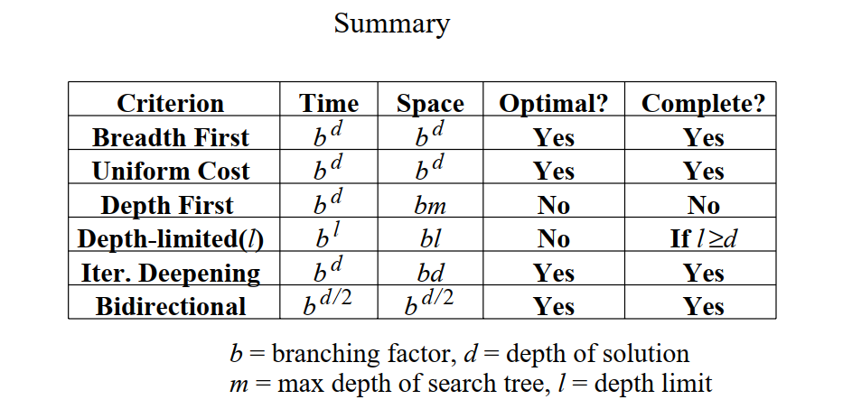

Slide 20
Informed Search

Slide 21
Informed search
So far, have assumed that no non-goal state looks better than another
Unrealistic
Even without knowing the road structure, some locations seem closer to the goal than others
Some states of the 8 puzzle seem closer to the goal than others
Makes sense to expand closer-seeming nodes first

Slide 22
Heuristics
Key notion: heuristic function h(n) gives an estimate of the distance from n to the goal
h(n)=0 for goal nodes
E.g. straight-line distance for traveling problem
Heuristic Search:
A heuristic search is a type of search performed by artificial intelligence (AI) that looks to find a good solution, not necessarily a perfect one using heuristic functions. Rather than focusing on finding an optimal solution like other search methods, heuristic searching is designed to be quick, and therefore finds the most acceptable option within a reasonable time.

Slide 23
Best-first search
Idea: use an evaluation function f(n) for each node
estimate of "desirability"
Expand most desirable unexpanded node
Implementation:
Order the nodes in fringe in decreasing order of desirability
Categories:
Greedy best-first search
A* search

Slide 24
Greedy best-first search
Greedy best-first search: expand nodes with lowest h values first. It expands the node that appears to be closest to goal.
Evaluation function f(n) = h(n) (heuristic)
= estimate of cost from n to goal
e.g., h_{SLD}(n) = straight-line distance from n to Bucharest

Slide 25
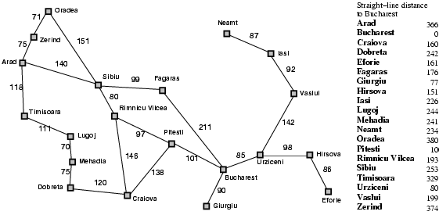
Romania with step costs in km

Slide 26

Greedy best-first search example

Slide 27
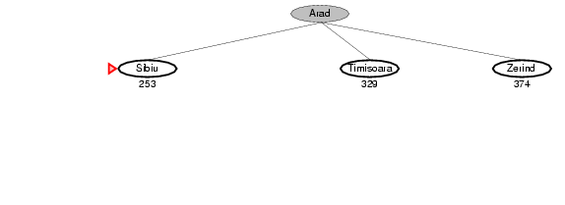
Greedy best-first search example

Slide 28
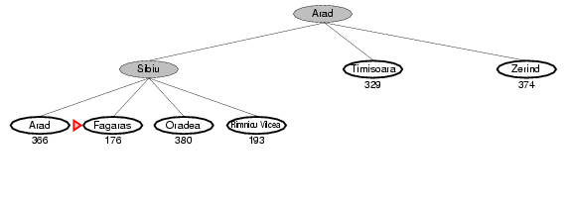
Greedy best-first search example

Slide 29
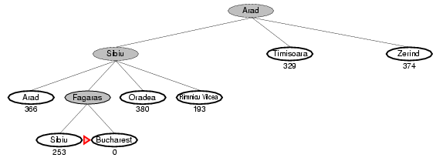
Greedy best-first search example

Slide 30
Greedy best first search evaluation Complete? No – can get stuck in loops e.g., Iasi → Neamt → Iasi → Neamt → ……. Time? O(b^{m}), but a good heuristic can give dramatic improvement Space? O(b^{m}) -- keeps all nodes in memory Optimal? No

Slide 31
A bad example for greedy
B
7
6
F
goal state
start state
A
E
4
3
D
4
Say: h(A) = 9, h(B) = 5, h(D) = 6, h(E) = 3, h(F) = 0
Problem: greedy evaluates the promise of a node only by how far is left to go, does not take cost incurred already into account

Slide 32
A* Search
Let g(n) be cost incurred already on path to n
Evaluation function f(n) = g(n) + h(n)
Expand nodes with lowest g(n) + h(n) first
g(n) = cost so far to reach n
h(n) = estimated cost from n to goal
f(n) = estimated total cost of path through n to goal
Properties:
Complete? Yes (unless there are infinitely many nodes with f ≤ f(G) )
Time? O(b^{d}) Exponential
Space? O(b^{d}) Keeps all nodes in memory
Optimal? Yes

Slide 33

A* search example

Slide 34
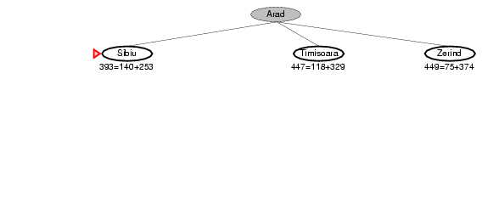
A* search example

Slide 35
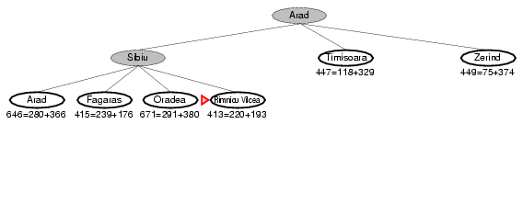
A* search example

Slide 36
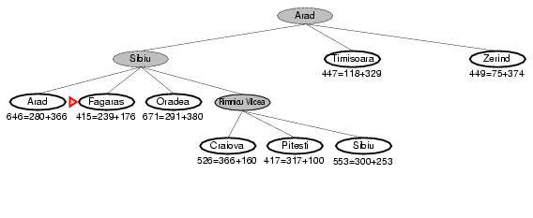
A* search example

Slide 37
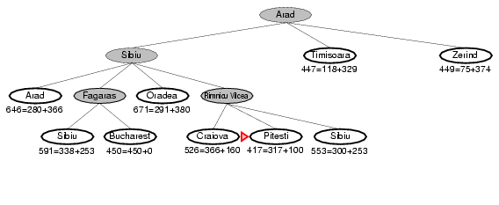
A* search example

Slide 38
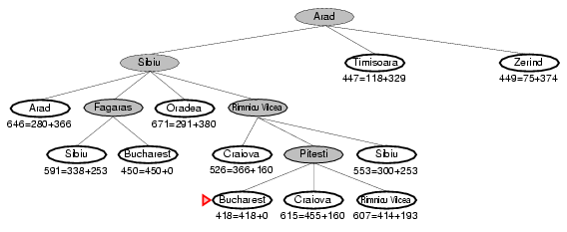
A* search example

Slide 39
Admissibility
A heuristic h(n) is admissible if for every node n,
h(n) ≤ h*(n), where h*(n) is the true cost to reach the goal state from n.
An admissible heuristic never overestimates the cost to reach the goal.
Admissible heuristic means that A* is always optimistic.
Straight-line distance is admissible: can’t hope for anything better than a straight road to the goal
Theorem: If h(n) is admissible, A* using TREE-SEARCH is optimal.

Slide 40
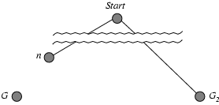
Optimality of A* (proof)
Suppose some suboptimal goal G₂ has been generated and is in the fringe. Let n be an unexpanded node in the fringe such that n is on a shortest path to an optimal goal G.
1. Assume A* has generated a suboptimal goal G2 and put it on the fringe
That means it's discovered G2 but hasn't expanded it yet. Since G2 is a goal, it has h(G2) = 0 (goals are at the end — no future cost). So: f(G2) = g(G2) + h(G2) = g(G2)
2. Let G be an optimal goal
Similarly: f(G) = g(G) + h(G) = g(G) (since h(G) = 0)
3. Suboptimal means it's more expensive
g(G2) > g(G) ⇒ f(G2) > f(G) So the suboptimal goal looks more expensive than the optimal goal.

Slide 41
Optimality of A* (proof)
4. Now consider n — a node on the optimal path to G
We want to show that A* will expand n before expanding G2. Using admissibility: h(n) ≤ h*(n) ⇒ f(n) = g(n) + h(n) ≤ g(n) + h*(n) But g(n) + h*(n) is the true cost of reaching the goal through n, so it's at most g(G): f(n) ≤ g(G) = f(G) So now: f(n) ≤ f(G) < f(G2) ⇒ f(n) < f(G2)

Slide 42
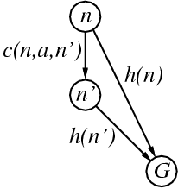
Consistent heuristics
A heuristic is consistent if for every node n, every successor n' of n generated by any action a,
h(n) ≤ c(n,a,n') + h(n')
If h is consistent, we have
f(n') = g(n') + h(n')
= g(n) + c(n,a,n') + h(n')
≥ g(n) + h(n)
≥ f(n)
i.e., f(n) is non-decreasing along any path.
Theorem: If h(n) is consistent, A* using GRAPH-SEARCH is optimal

Slide 43
Relaxed Problems
A relaxed problem is a modified version of an original problem that removes or reduces certain constraints on possible actions. The solution to a relaxed problem provides a useful admissible heuristic for the original problem, as the optimal cost of the relaxed version will never overestimate the true cost of the original problem.
8-Puzzle Example:
Fully Relaxed Rules: If tiles can move anywhere (ignoring adjacency), the number of misplaced tiles (h₁(n)) becomes an admissible heuristic, equal to the shortest solution.
Partially Relaxed Rules: If tiles can move only to any adjacent square (ignoring blank space requirements), the Manhattan distance (h₂(n)) serves as an admissible heuristic, reflecting the minimal moves needed.

Slide 44
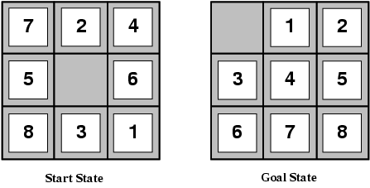
Admissible heuristics (8 puzzle)
E.g., for the 8-puzzle:
h₁(n) = number of misplaced tiles
h₂(n) = total Manhattan distance
(i.e., number of squares from desired location of each tile)
h₁(S) = ? 8
h₂(S) = ? 3+1+2+2+2+3+3+2 = 18
If h₂(n) ≥ h₁(n) for all n (both admissible)
then h₂ dominates h₁
h₂ is better for search
h2​(S): Manhattan distance (the total number of moves each tile is away from its correct position).
Manhattan distance, h2(S) = (row difference) + (column difference).

Slide 45
Admissible heuristics (8 puzzle)
E.g., for the 8-puzzle:
h₁(n) = number of misplaced tiles
h₂(n) = total Manhattan distance
(i.e., number of squares from desired location of each tile)
Calculation of h2(S):
h₂(S) = ? 3+1+2+2+2+3+3+2 = 18
If h₂(n) ≥ h₁(n) for all n (both admissible)
then h₂ dominates h₁
h₂ is better for search
Tile 1: Start (row3,col3) → Goal (row1,col2) → distance = 3
Tile 2: Start (1,2) → Goal (1,3) → distance = 1
Tile 3: Start (3,2) → Goal (2,1) → distance = 2
Tile 4: Start (1,3) → Goal (2,2) → distance = 2
Tile 5: Start (2,1) → Goal (2,3) → distance = 2
Tile 6: Start (2,3) → Goal (3,1) → distance = 3
Tile 7: Start (1,1) → Goal (3,2) → distance = 3
Tile 8: Start (3,1) → Goal (3,3) → distance = 2
Now add them:
3+1+2+2+2+3+3+2=18

Slide 46
Local Search
Local search is a class of optimization algorithms that focus on evaluating and improving the current state rather than systematically exploring paths from an initial state.
Key Characteristics:
Memory Efficient: Stores only the current state, reducing memory usage.
Neighbor-Based Movement: Explores neighboring states to iteratively improve the solution.
Solution-Oriented: Ideal for problems where only the final solution matters, not the path cost.
Local search is widely used in optimization problems such as function maximization, and machine learning.

Slide 47
Hill Climbing Search
The Hill Climbing Search algorithm in Artificial Intelligence is a local search algorithm used for optimization problems. It operates by continuously moving in the direction of increasing elevation or value within a search space, aiming to find a peak or optimal solution.
Hill Climbing is a local search algorithm inspired by the idea of climbing a hill in the dark (blindfolded). The agent can only sense its immediate surroundings and moves in the direction that appears to lead upward, aiming to reach the highest point (the goal).
Key Characteristics:
Blindfolded Agent: The algorithm only knows the current state and its neighbors (local information).
Heuristic-Driven: Uses a heuristic (e.g., distance to goal, function value) to decide the next move.
Greedy Approach: Always chooses the neighbor that improves the current state (e.g., reduces distance to goal).
No Backtracking: Once it moves to a new state, it does not revisit previous states.
Example: Imagine climbing a fog-covered hill where you can only feel the slope under your feet. You take steps uphill until no higher step is available—this is your peak (either local or global maximum).
Limitation:
Local Maxima: May get stuck at a peak that isn’t the highest.

Slide 48
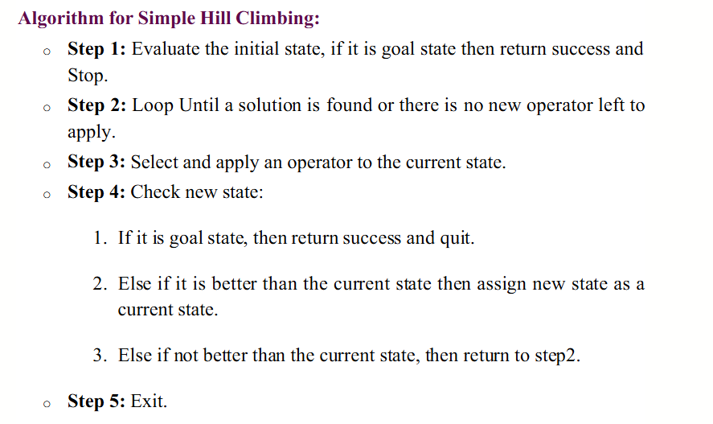
Hill Climbing Algorithm

Slide 49
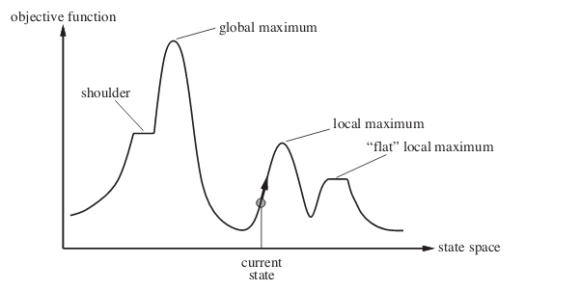
Hill Climbing Example

Slide 50
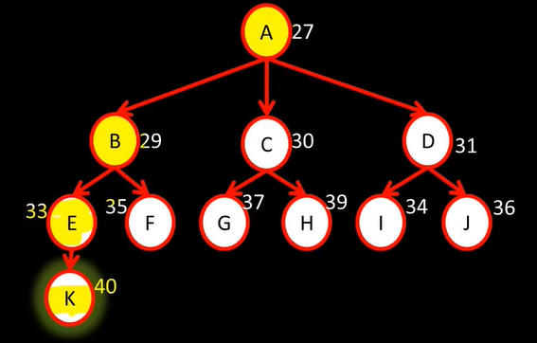
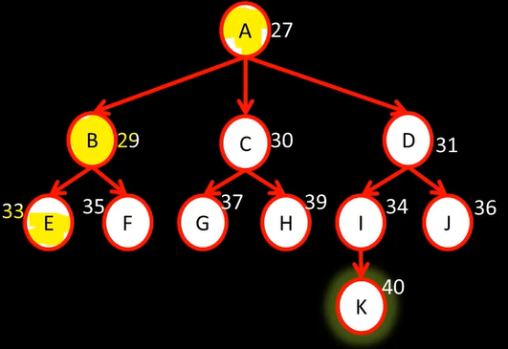
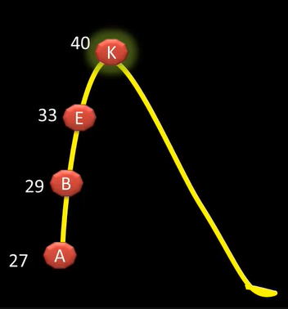

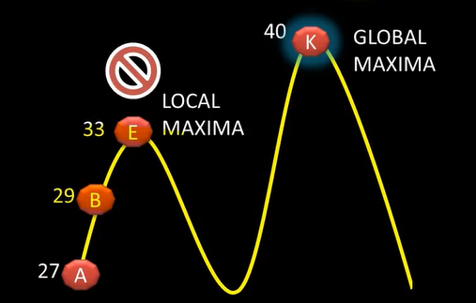
Hill Climbing Example

Slide 51
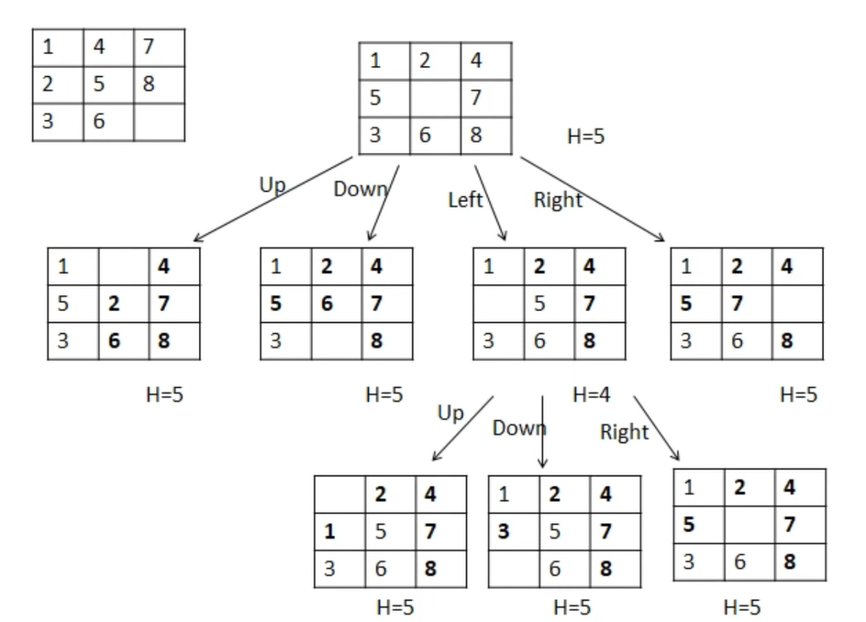
Hill Climbing Example
Goal State
Initial State
H = number of misplaced tiles
Local maxima

Slide 52
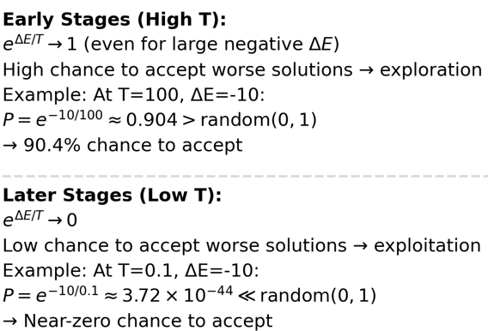
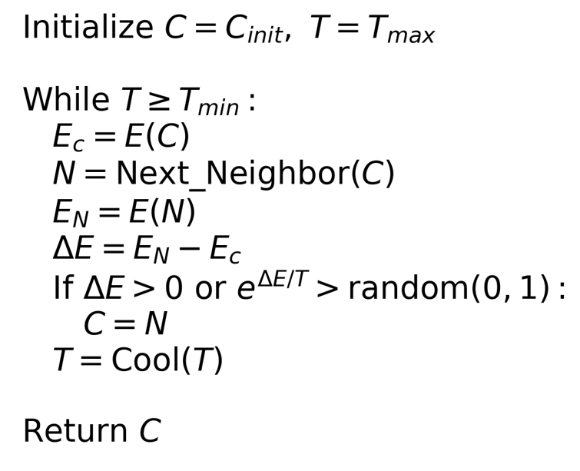
Simulated annealing search
​Idea: escape local maxima by allowing some "bad" moves but gradually decrease their frequency
Algorithm:

Slide 53
Genetic Algorithm
​Genetic Algorithms (GAs) are evolutionary computation techniques inspired by biological evolution, used to solve optimization and search problems. They mimic natural selection by evolving a population of candidate solutions over generations.
Steps
Population: A set of potential solutions (chromosomes) encoded as strings (binary, real-valued, etc.).
Fitness Function: Evaluates the quality of each solution (e.g., shorter tours in TSP get higher fitness).
Selection: Fitter solutions are more likely to be chosen as parents.
Crossover (Recombination): Combines parts of two parent chromosomes to create offspring.
Mutation: Introduces small random changes (e.g., flipping bits) to maintain diversity.
Termination: Stops when a solution meets criteria or after a fixed number of generations.

Slide 54
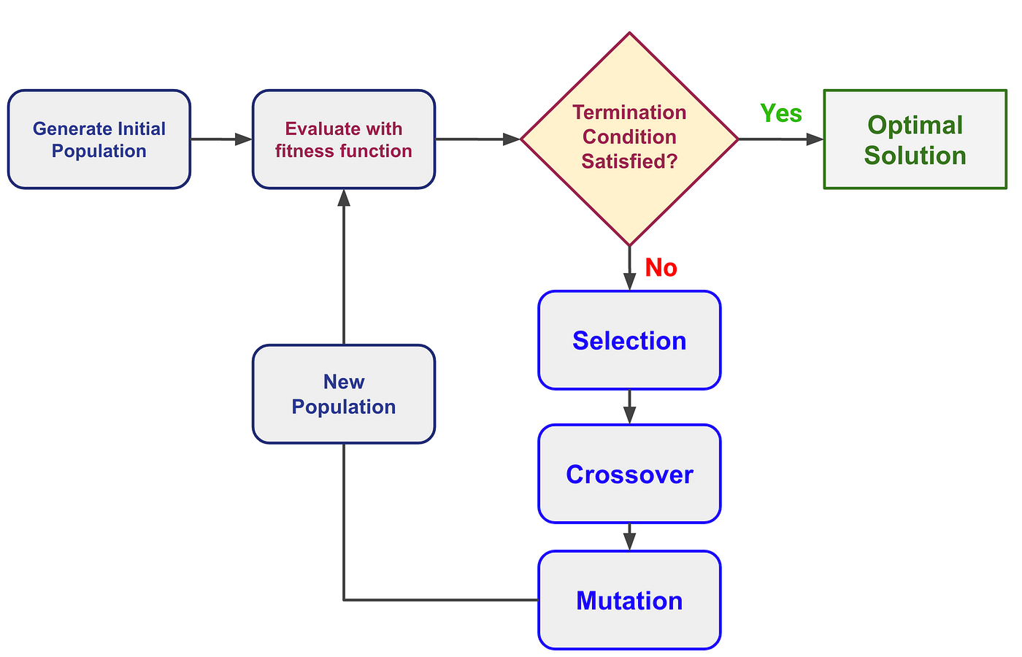
Genetic Algorithm

Slide 55
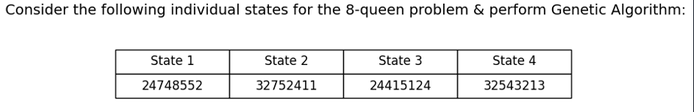
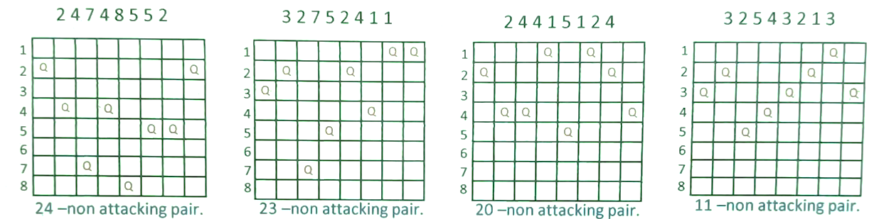
Genetic Algorithm Example

Slide 56
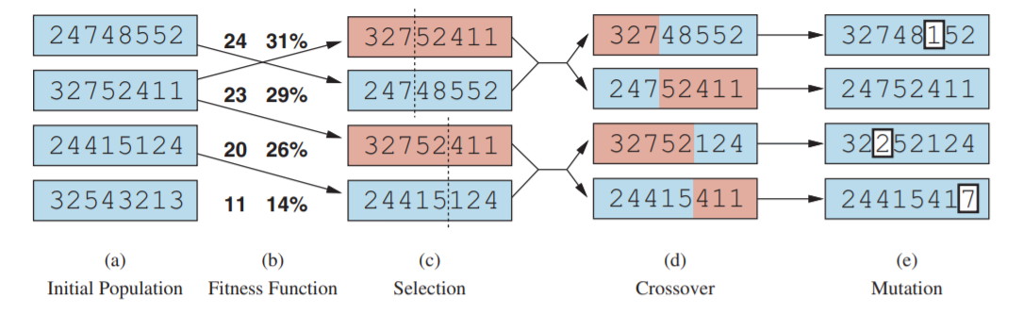
Genetic Algorithm Example
Fitness function: number of non-attacking pairs of queens (min = 0, max = 8 × 7/2 = 28)
24/(24+23+20+11) = 31%
23/(24+23+20+11) = 29% etc

Slide 57
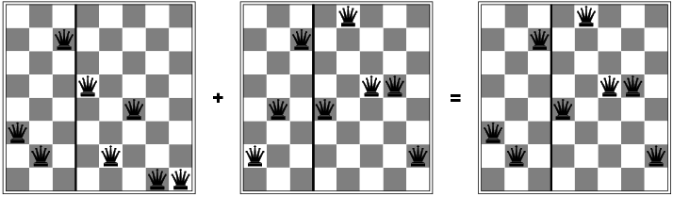
Genetic Algorithm Example

